Slide 1
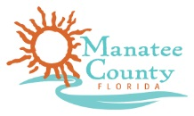
Washington Park Neighborhood Action Plan (NAP)
Action Item Summary
April 2019
Prepared For
Manatee County Government
Neighborhood Services Department
1112 Manatee Ave. W., 5th Floor
Bradenton, Florida 34205

Slide 2
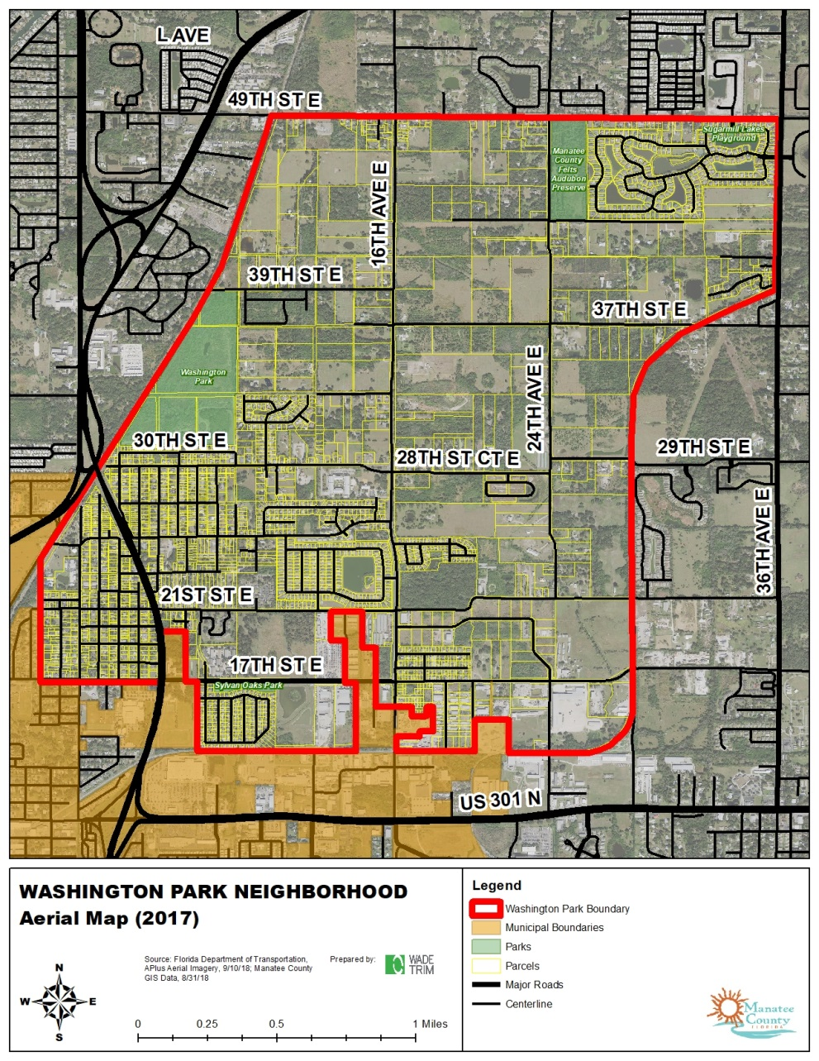
Introduction
Background
Locally known as “Memphis” or “Washington Park”
From 17th Street East (Memphis Road) to 49th Street East, between existing railway lines
3.78 square miles (2,418 acres)
Recent County planning and capital improvements efforts (e.g. parks, trails, sidewalks, drainage, etc.)
Purpose of NAP
Examine development/ redevelopment potential of Washington Park as a whole
Identify community needs
Develop a strategy to enhance the neighborhood’s integrity and stability

Slide 3
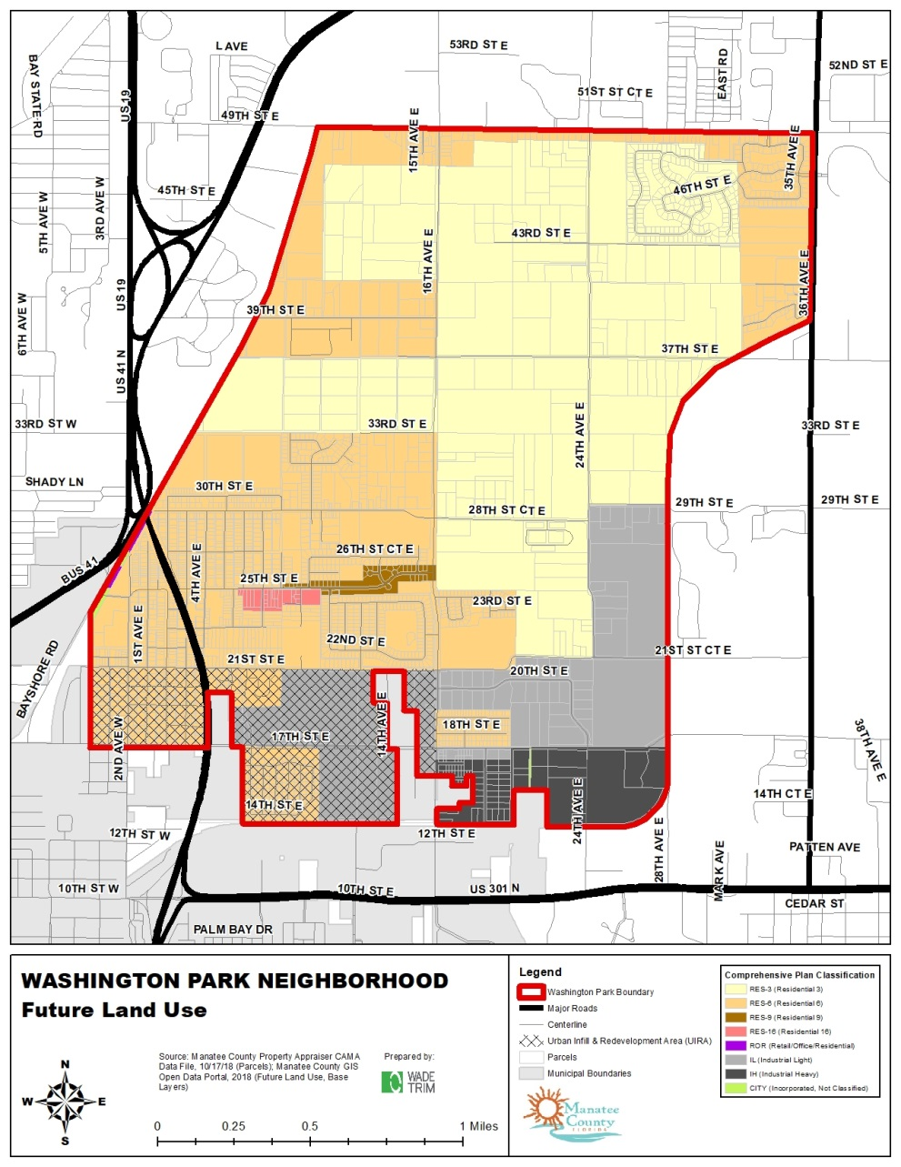
Existing Conditions & Building Function
Land Use and Zoning
Current mix of agricultural, residential, and non-residential uses, rights-of-way, utilities and drainage easements
Zoning is agricultural, residential, and manufacturing
Future Land Use is mostly residential, with some non-residential (light and heavy industrial) to south at 17th Street East

Slide 4
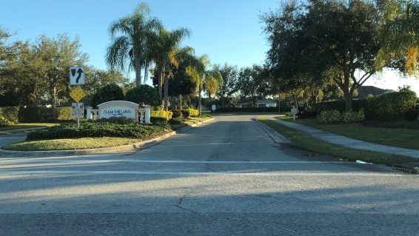
Existing Conditions & Building Function
Property Ownership, Values
83% of parcels uniquely owned, less than one-acre
Balance of ownership by government, residential developers, and limited liability corporations (LLCs)
Highest valued properties are institutional or industrial uses
Residential values highest in Sugar Mill Lakes and Palmetto Estates neighborhoods or some properties outside of subdivisions with newer construction
Median sales price of residential home is $200,000
Buildings
Approximately 2,024 buildings (1,897 residential and 127 non-residential)
Avg. residential gross floor area: 1,837 sf
Avg. non-residential gross floor area: 7,429 sf
Residential buildings most concentrated in older platted neighborhoods west of 16th Avenue East (Canal Road) and north of 17th Street East (Memphis Road)
Industrial and manufacturing buildings most concentrated along 17th Street East (Memphis Road)
Agricultural buildings throughout neighborhood
Most buildings constructed after 1980, except for older platted neighborhoods near U.S. 41, where building rehabilitation is needed

Slide 5
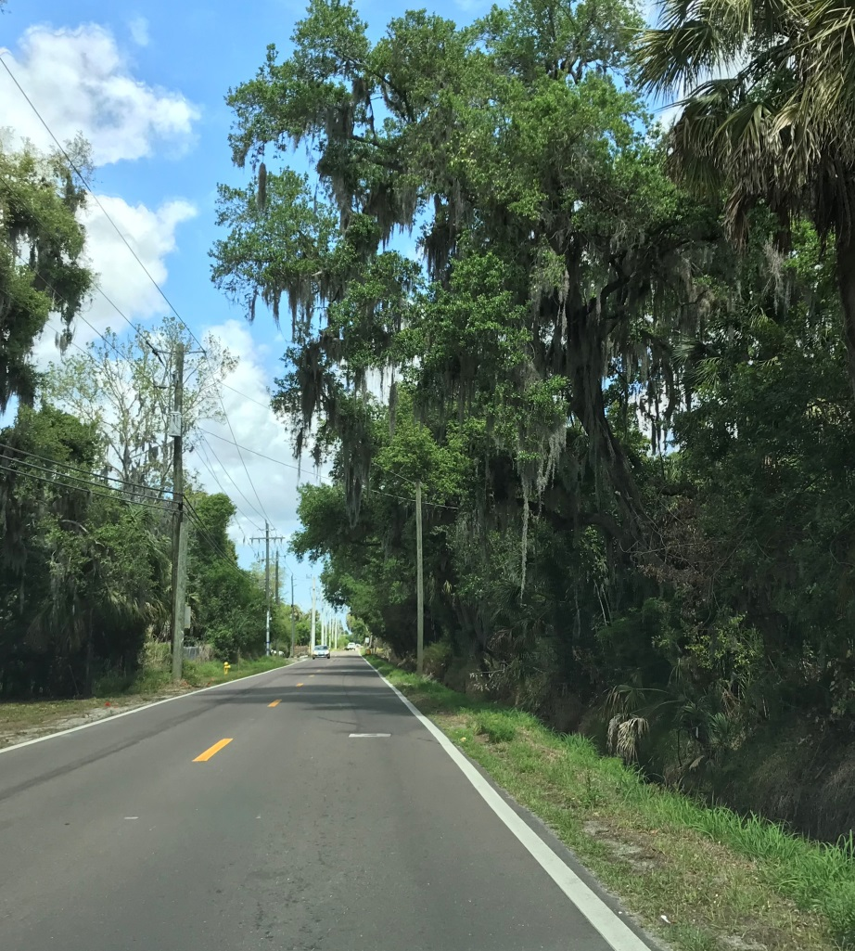
Existing Conditions & Building Function
Public Facilities & Infrastructure
Electricity by Florida Power & Light Company (FPL) and Peace River Electric Cooperative (PRECO)
Manatee County public water and sewer to existing neighborhoods and subdivisions
Potable water main line runs along 16th Avenue East (Canal Road)
Rural properties served by well and septic tanks
No reclaimed water
Solid waste collection twice weekly
Network of ditches and canals in public right-of-way manages stormwater

Slide 6
Existing Conditions & Building Function
Transportation
Grid-based network of local streets
Major urban streets include 49th Street East, 17th Street East (Memphis Road), and 16th Avenue East (Canal Road)
Principal main street U.S. 41 from 29th Street East to 17th Street East (Memphis Road)
Limited street lighting
Few public sidewalks due to large canals and open ditches that consume right-of-way width
Most accidents at intersections with U.S. 41 where traffic volume is highest
MCAT Route 13 goes through the neighborhood – Most of area unserved by public transit

Slide 7
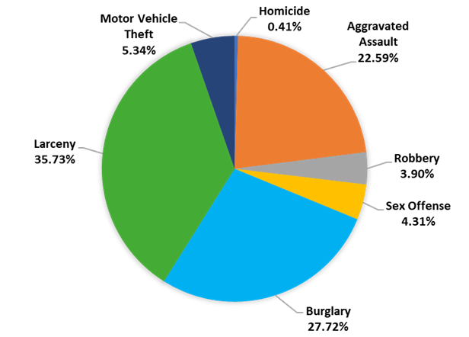
Existing Conditions & Building Function
Code Enforcement & Criminal Activity
Most frequent code enforcement includes overgrown conditions, junk vehicles, trash and debris
Average of 200 crimes annually since 2013
Crimes most concentrated west of 16th Avenue East (Canal Road) and south of 29th Avenue East

Slide 8
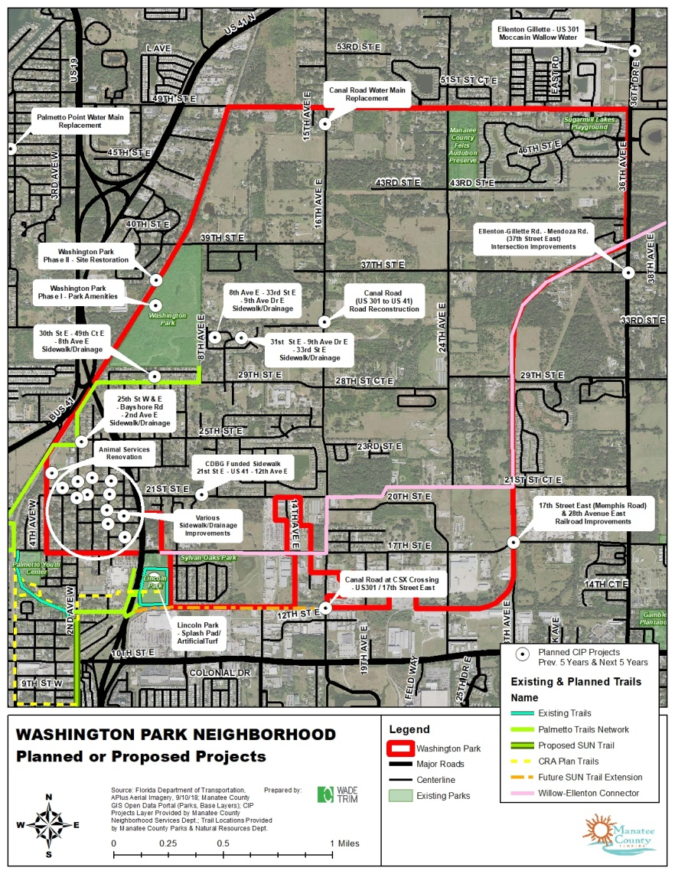
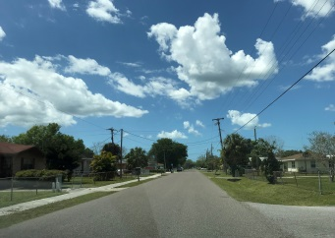
Existing Conditions & Building Function
Planned Public Facilities
Washington Park Borrow Pit Restoration & Park Amenities (88 Acres)
Palmetto Trails Network
Willow-Ellenton Trail Connector
Lincoln Park Improvements
Manatee County FY 2019-2023 CIP
24 projects in Washington Park
16th Avenue East (Canal Road) Reconstruction
Sidewalk construction
Drainage improvements
Water Distribution System Master Plan
30th Street East
37th Street East from 16th Avenue East (Canal Road) to 36th Avenue East (Ellenton-Gillette Road)

Slide 9
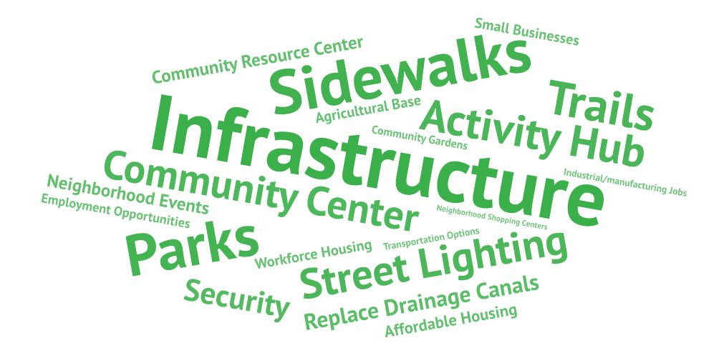
Community Stakeholder Consultation
Consultation Efforts
Focus Group Meetings (2) on October 25, 2018 with County staff & community leaders
Phone Interviews (9) with residents, workers, church leaders, community activists, local business owners, and large property owners
Community Priorities

Slide 10
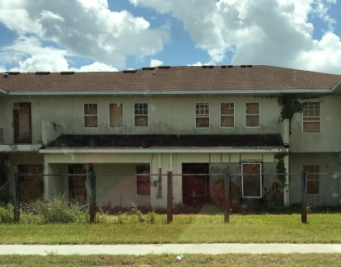
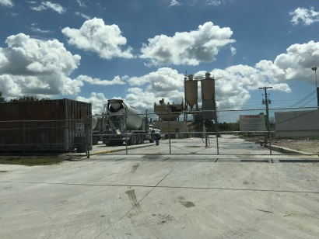
Community Stakeholder Consultation
Concerns of Businesses and Property Owners
Threats?
Decline of properties/property values
Transient/seasonal population
Infrastructure (streets, sewer, drainage, sidewalks etc.) and transportation deficiencies
Competition with other economic generators at I-75 (e.g. SR 64 and Ellenton interchanges) and US 301 (e.g. Whitfield Avenue Industrial)
Opportunities?
Transportation improvements (road widening, paving, intersections)
Need for public facilities and amenities
Improvements to local economy within neighborhood
Capitalize on proximity to I-275 and St. Petersburg/Pinellas County market for light industrial/manufacturing and trade-related occupations
Availability of affordable/workforce housing, job training in manufacturing and trade-related occupations, and existing light industrial and manufacturing businesses at 17th Street East

Slide 11
Socioeconomic Market Data
Demographics
Young, educated, diverse population
48% Black or African American and 34% Hispanic (north of 17th Street East / Memphis Road)
Housing
High percentage of homeownership and occupied units
Mostly detached single family units that are aging
Household incomes, housing values, and rents remain lower than other areas of County
Employment
High unemployment rate and high percentage of low- and moderate-income persons
Need for targeted reinvestment and job training in specific business sectors with labor deficits (e.g. agriculture/mining, arts/entertainment/accommodations, manufacturing, retail trade, wholesale trade)

Slide 12
Market & Trade Area Conditions & Analysis
Stores just outside 1-mile radius satisfy overall demand within trade area (e.g. Walmart on U.S. 301)
Stores within 3-mile radius more than satisfy demand within trade area
No major store demand not satisfied at 3-mile radius
Market Conditions
Retail gap analysis within Washington Park shows that only two types of stores have no opportunity (i.e., electronic/appliance and clothing/accessories stores)
Most major active property listings in Washington Park are for commercial, industrial, and warehouse properties
Retail, office, and industrial space rents are in-line with Bradenton and south county markets
Average asking price for commercial property is $90,000/acre and industrial property is $107,000/acre

Slide 13
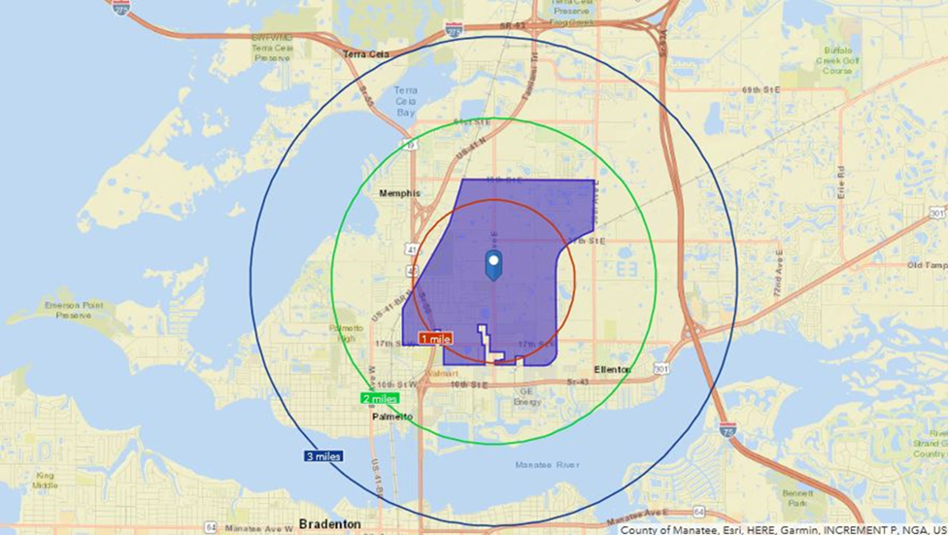
Development/Redevelopment Suitability
ASSETS
3 miles to City of Bradenton (south)
3 miles to Ellenton Premium Outlets Mall (east)
2 miles to Benderson Florida International Trade Port (east)
Easy access to I-275 (St. Petersburg) and I-75 (Hillsborough and Sarasota counties)
BARRIERS
Geography/Isolation
(e.g. Manatee River/Terra Ceia Bay, Interstates/ Highways)
No “front door” – Lack of access/visibility (e.g. narrow roads with few access points)
Competition from nearby U.S. 301 corridor / Bradenton market
Opportunities
Intersection improvements to U.S. 301 / 16th Avenue East (Canal Road) intersection
Synergy with Manatee County capital improvement dollars (parks, trails, infrastructure)
Significant amount of vacant land potentially available for residential or mixed use development
Potential for significant growth in industrial and manufacturing industries
Nearby employment opportunities adjacent to I-75 at Ellenton interchange

Slide 14
Redevelopment Concept Plan
Redevelopment Concept Plan
“Front door” signage for visibility
New community center “focal point” with trail connectors to County-planned facilities and larger trail systems
Continue residential and business redevelopment and capital projects per County Capital Improvement Plan (CIP)
Expand existing redevelopment area (UIRA) and allow Accessory Dwelling Units (ADUs) to support workforce/affordable housing in existing platted neighborhoods
Develop new workforce/affordable housing to support nearby skilled employment centers
Develop transportation alternatives to allow for connections with light industrial area along 17th Street East (Memphis Road) to improve employment opportunities
Consider Complete Streets in conjunction with other projects (e.g. road widening/stormwater improvements)

Slide 15
Implementation Strategy: Manatee County What the County can do…
Neighborhood Enhancement – Immediate & Continuing
Identify leaders within each of the neighborhood’s communities and provide leadership training
Develop programs or projects to reduce crime using Crime Prevention Through Environmental Design (CPTED) techniques
Community Development – Immediate & Continuing
Apply for grants or seek available funding to provide for community enhancements (ex. Neighborhood Enhancement Grant)
Partner with nonprofit organizations and private developers to build market-grade and workforce/affordable housing
Work with partners and support programs to increase income levels of low-income households such as workforce preparation/job training and employment initiatives.
Community Identity & Wayfinding – Next 3 Years
Identify projects that will establish a positive sense of community identity
Develop a signage program (opportunity for Neighborhood Enhancement Grant)
Add gateway/wayfinding signage at key intersections

Slide 16
Implementation Strategy: Manatee County What the County can do…
Economic Development & Redevelopment – Next 3 Years
Continue to work with large property owners to implement Redevelopment Concept Plan
Update County’s Comprehensive Plan and Zoning to correspond to Redevelopment Concept Plan
Expand UIRA in short-term and consider designation of Urban Corridors on select roadways as neighborhood transitions from rural/suburban to urban in character
Allow by policy Accessory Dwelling Units (ADUs) on existing platted lots in established neighborhoods as means of supporting workforce/affordable housing
Secure funding for incentives for business attraction and retention
Secure funding to hire a public relations firm to develop an image and marketing program, strategies, and materials
Develop an implementation schedule for marketing, to include success milestones
Begin (or continue) conversation and marketing with Benderson Florida International Trade Port and/or brokers as to advantages of Washington Park neighborhood’s location and industrial zoning districts

Slide 17
Implementation Strategy: Manatee County What the County can do…
Public Facilities & Infrastructure – Next 3, 5, and 10 Years
Start construction of Washington Borrow Pit reclamation/public park project (funded) (by 2023)
Plan and construct trail network (partially funded) (by 2023)
Complete planned traffic light and related improvements at 16th Avenue East (Canal Road) and U.S. 301 (by 2023)
Collaborate with FY 2019-2023 CIP, planned sidewalk/drainage improvements, and streetscape projects (by 2023)
Appropriate funds for land acquisition, design, and construction of a Community Center building (by 2023)
Negotiate with Manatee County Housing Authority for their land on 28th Street Court East (15 acres) toward construction of Community Center building (by 2023)
Fill canals along 16th Avenue East (Canal Road) and widen 16th Avenue East (Canal Road) (see FY 2019-2023 CIP, requires engineering/stormwater considerations) (by 2025)
Design Community Center building (by 2025)
Complete reconstruction and widening of 16th Avenue East (Canal Road) (by 2030)
Complete construction of Community Center building (by 2030)

Slide 18
Implementation Strategy: Community Action What residents can do now…
Neighborhood Enhancement
Neighborhood residents and homeowner association (HOA) leaders to improve overall aesthetics, landscaping, and beautification of common areas (opportunity for Neighborhood Enhancement Grant)
Residents, property owners, and local nonprofit organizations to identify and utilize vacant sites for neighborhood gardens
Community Development
Utilize County’s CDBG and HOME homebuyer education, down payment assistance, housing repair, and housing replacement program for owner-occupied housing (residents must apply to County for these benefits) https://www.mymanatee.org/departments/redevelopment___economic_opportunity/community_development/housing_programs
Economic Development & Redevelopment
Community Development Corporations (CDCs) to seek funding from New Market Tax Credits
Public Facilities & Infrastructure
Work with County staff to prepare a “Streetscape and Lighting Plan” to prioritize streets in Washington Park neighborhood – continue to support sidewalk and drainage improvements

Slide 19
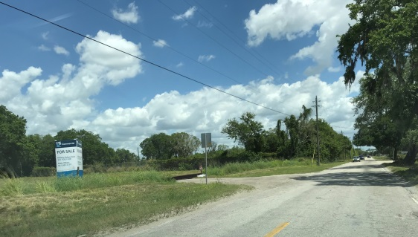
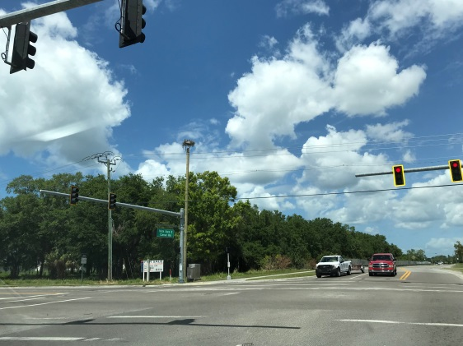
Potential Incentives & Funding Sources
Potential Incentives
Brownfields initiatives
Regulatory assistance
Manatee County Rapid Response Team
Manatee County Economic Development Incentives
Economic Development Incentive (EDI)
Multi-Modal Transportation Impact Fee Incentive (MTIFI)
Economic Development Ad Valorem Tax Exemption (EDAVTE)
Manatee County Urban Infill & Redevelopment Area (UIRA)
Funding Sources
Capital Revolving Loan Program (CRLP)
Flexible SBA 7(a) (Loan Growth American Fund)
Manatee County General Fund
Manatee County ½ Cent Infrastructure Sales Tax
Manatee County Neighborhood Enhancement Grant Program
Community Development Block Grant (CDBG) and HOME Investment Partnership Program
State Housing Initiative Partnership (SHIP) Program

Slide 20
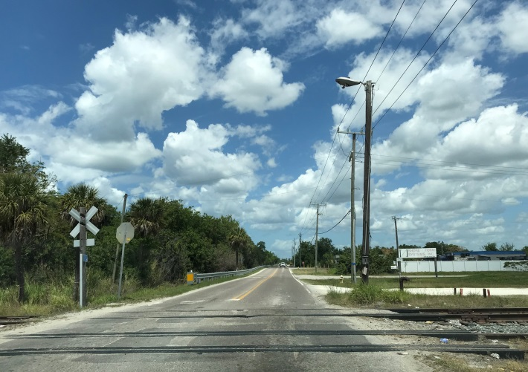
Conclusion
For more information regarding the Washington Park Neighborhood Action Plan (NAP), contact:
Debbie DeLeon, Neighborhood Services Coordinator
Neighborhood Services Department
1112 Manatee Avenue West
Bradenton, FL 34205
(941) 749-3029 x3482
Washington Park is challenged by geography, narrow internal roadways, and deep ditches
Washington Park benefits from established neighborhoods, planned public projects, and proximity to light industrial/flex space employment centers
Well positioned for new residential development
Goals of the NAP
Improve connectivity and qualify life
Improve housing stock
Improve property values
Improve earning potential within the neighborhood
Summary of Action Items
Complete planned public projects
Acquire land and design new Community Center
Collaborate and partner with nonprofits and developers
Create connection between workforce/affordable housing, light industrial/flex space development, and targeted job training

